Slide 1
Exploring & Visualizing of World bank Co2 Emission dataset

Slide 2
Dataset
After cleaning and adding meta data, dataset contains over 13342 observation and 11 different columns.
Each country data spreading across 1960-2018.
Dataset download from : http://data.worldbank.org/indicator/EN.ATM.CO2E.PC/

Slide 3
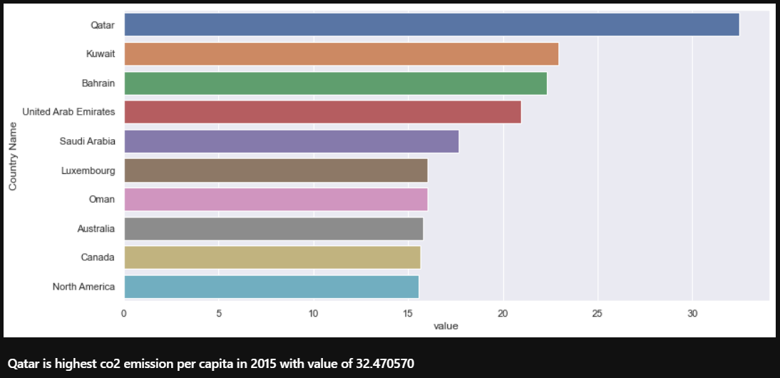
Which countries have the highest CO2 emissions per capita in 2015?

Slide 4
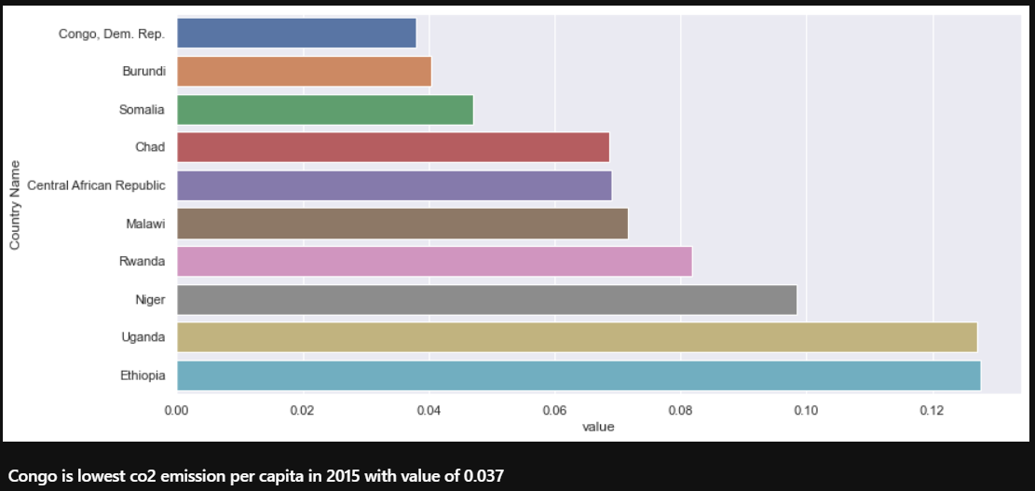
Which countries have the Lowest CO2 emissions per capita in 2015?

Slide 5
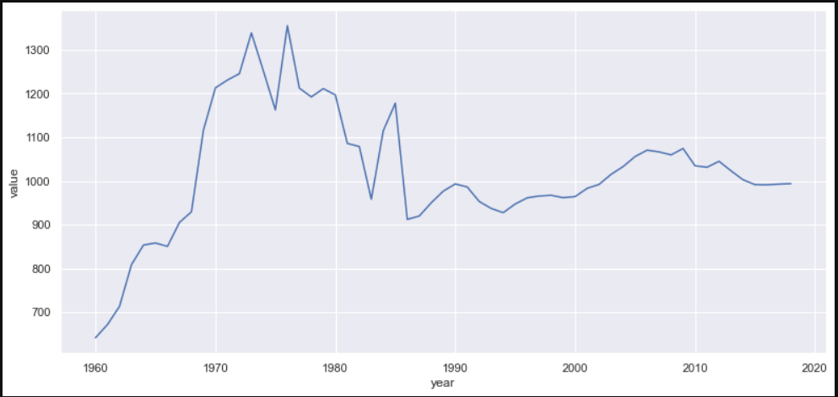
Co2 Emission changes over year

Slide 6
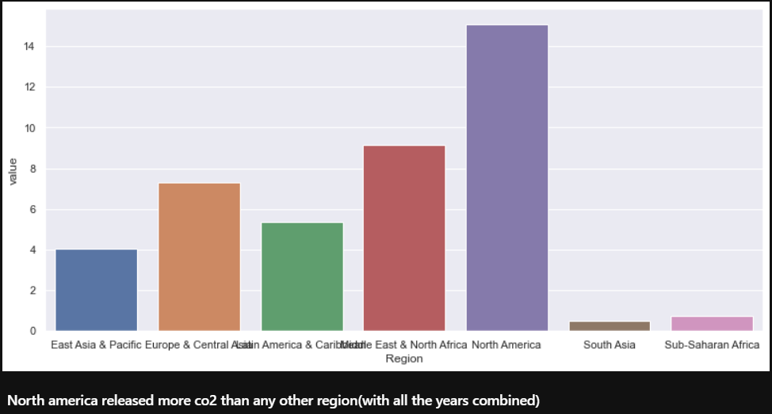
Co2 Emission based on region

